Slide 1


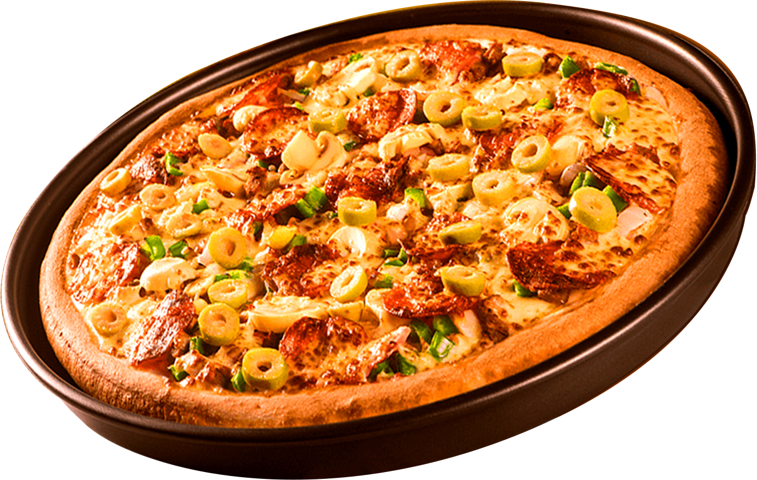

RIYA DEMAPURE
PIZZA SALES ANALYSIS
Using SQL
UNLOCKING INSIGHTS FROM PIZZA SALES DATA
NEXT >

Slide 2

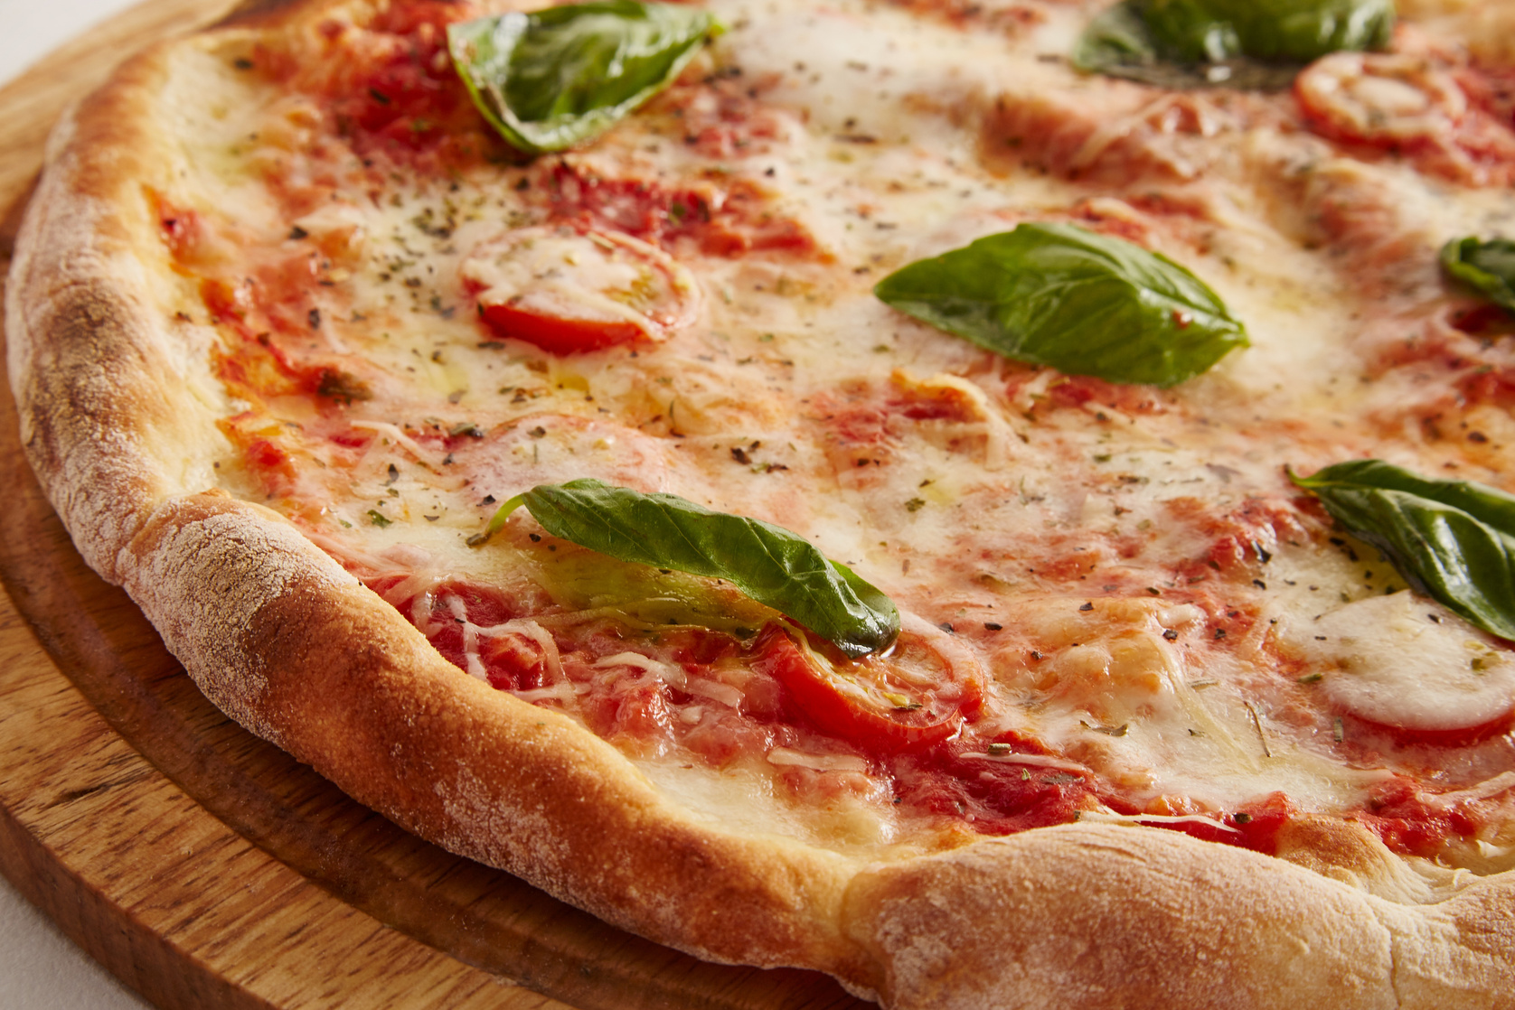
INTRODUCTION
This project focuses on analyzing pizza sales data using SQL to uncover key business insights. By applying advanced SQL techniques, we aim to identify patterns, understand customer behavior, and support better business decisions.
< BACK
NEXT >

Slide 3
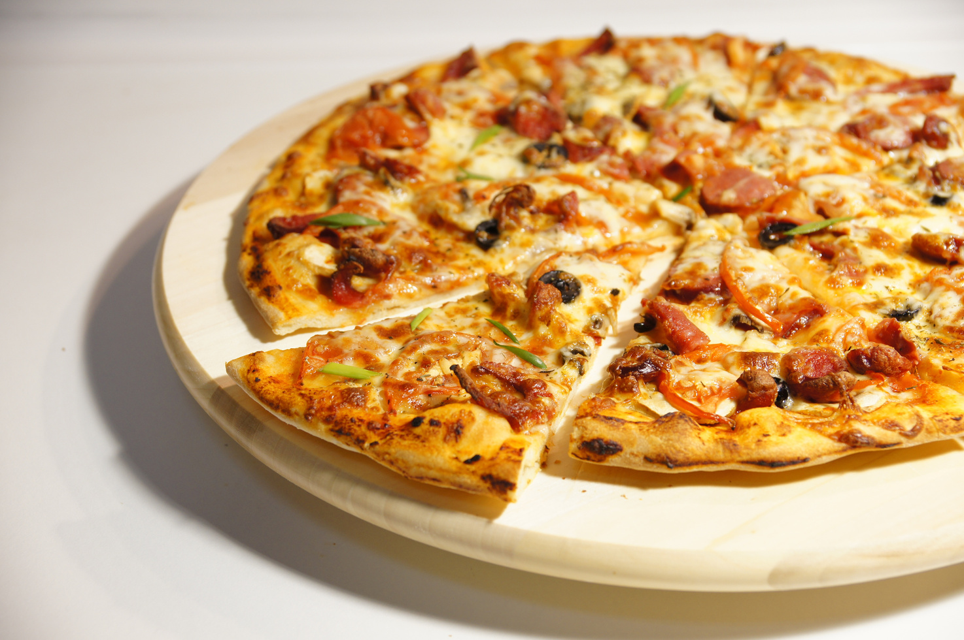
OBJECTIVES
• Analyze pizza sales data using SQL
→ Explore trends in pizza orders and customer preferences.
• Solve real-world business questions using queries
→ Answer practical questions related to revenue, order timing,
and product popularity.
• Apply Joins, Aggregations, Window Functions, and Date Functions
→ Combine and process data from multiple tables efficiently.
• Identify sales trends, top-performing pizzas, and order patterns
→ Discover which pizzas perform best and at what times.
• Generate insights to support data-driven business decisions
→ Turn raw data into meaningful insights for strategy and planning
< BACK
NEXT >

Slide 4
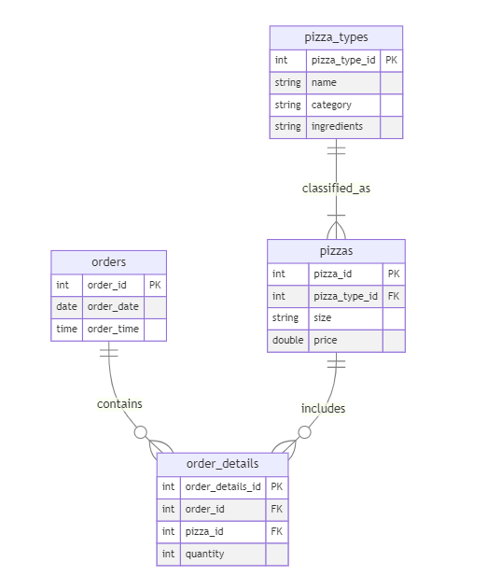
DATABASE
SCHEMA
< BACK
NEXT >

Slide 5
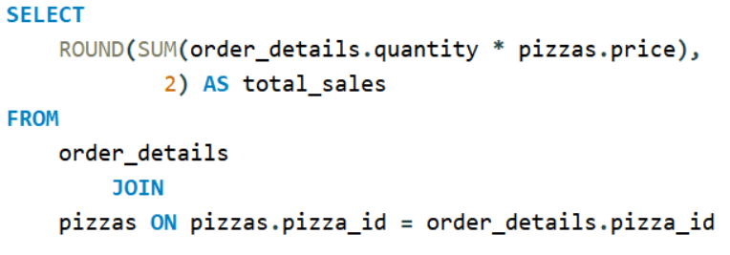
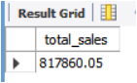
CALCULATE THE TOTAL REVENUE GENERATED FROM PIZZA SALES.
< BACK
NEXT >

Slide 6
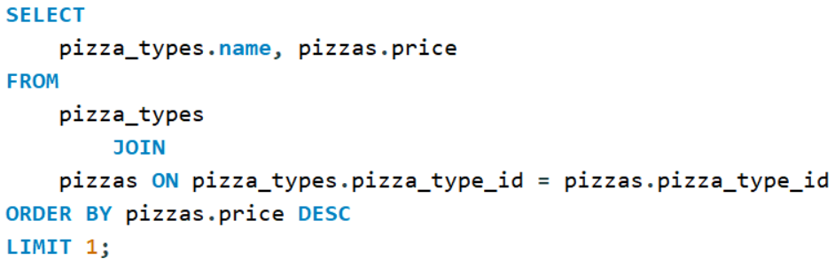
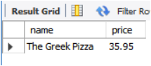
IDENTIFY THE HIGHEST-PRICED PIZZA.
< BACK
NEXT >

Slide 7
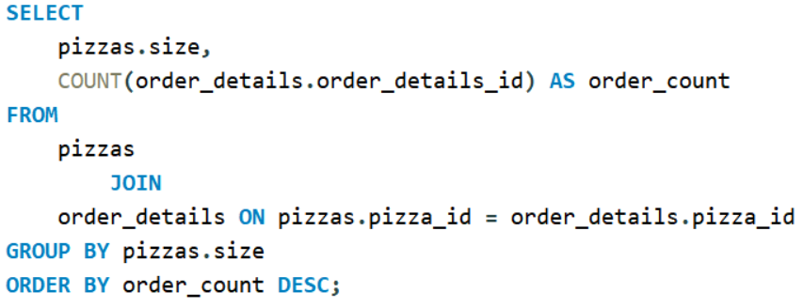
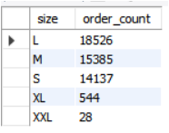
IDENTIFY THE MOST COMMON PIZZA SIZE ORDERED.
< BACK
NEXT >

Slide 8
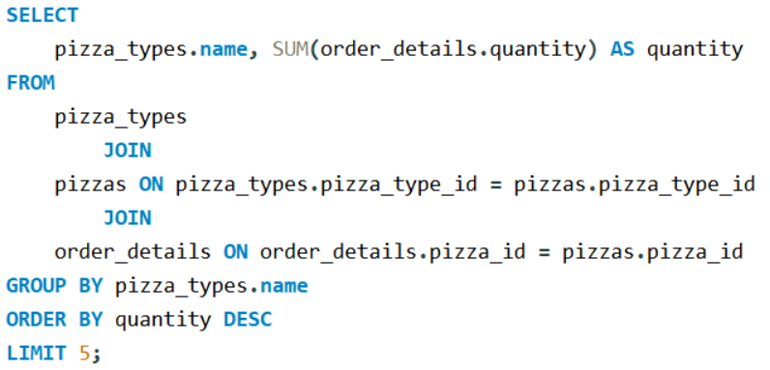
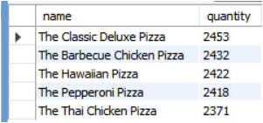
LIST THE TOP 5 MOST ORDERED PIZZA TYPES ALONG WITH THEIR QUANTITIES.
< BACK
NEXT >

Slide 9
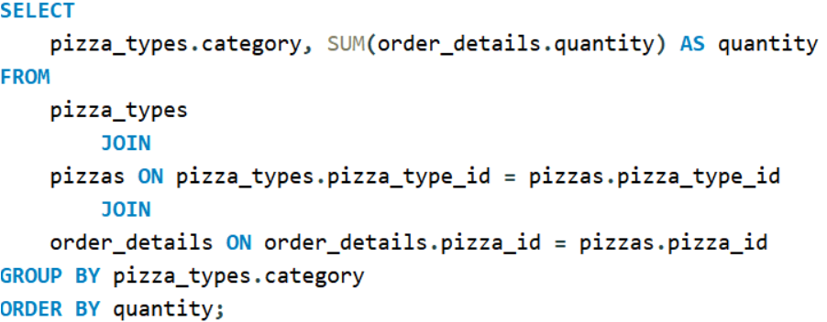
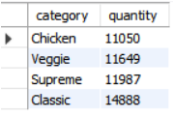
JOIN THE NECESSARY TABLES TO FIND THE TOTAL QUANTITY OF EACH PIZZA CATEGORY ORDERED.
< BACK
NEXT >

Slide 10
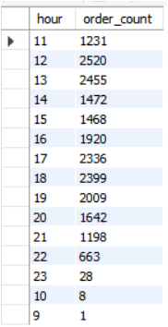
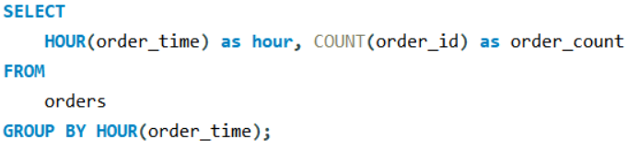
DETERMINE THE DISTRIBUTION OF ORDERS BY HOUR OF THE DAY.
< BACK
NEXT >

Slide 11
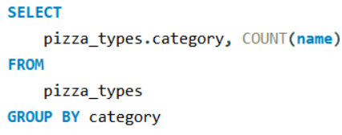
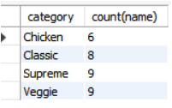
JOIN RELEVANT TABLES TO FIND THE CATEGORY-WISE DISTRIBUTION OF PIZZAS.
< BACK
NEXT >

Slide 12
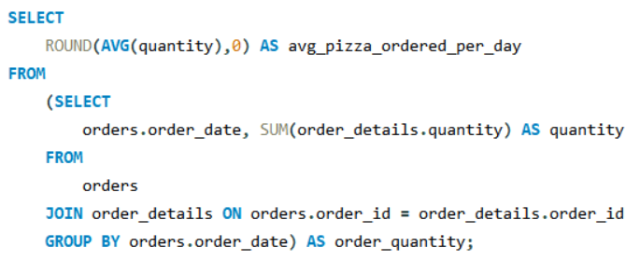
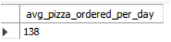
GROUP THE ORDERS BY DATE AND CALCULATE THE AVERAGE NUMBER OF PIZZAS ORDERED PER DAY.
< BACK
NEXT >

Slide 13
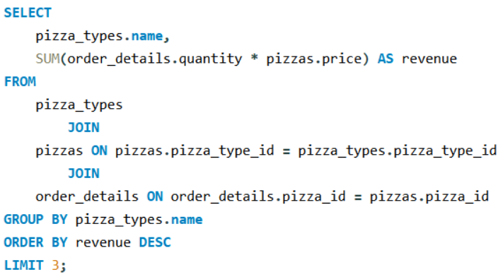
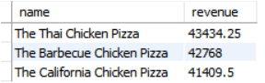
DETERMINE THE TOP 3 MOST ORDERED PIZZA TYPES BASED ON REVENUE.
< BACK
NEXT >

Slide 14
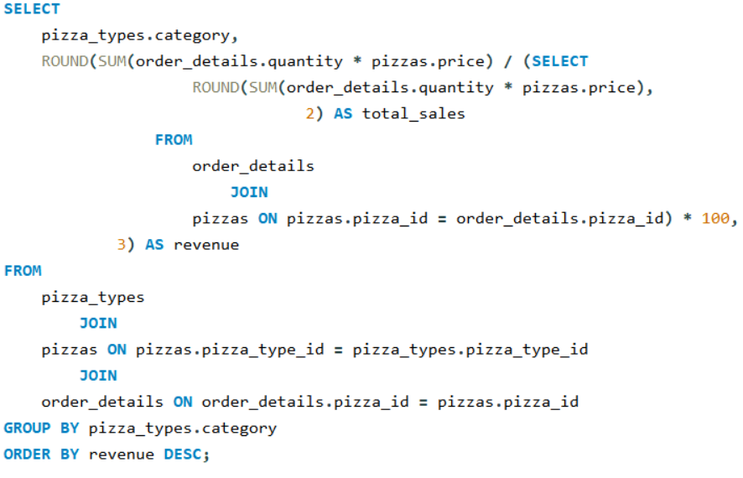
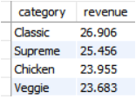
CALCULATE THE PERCENTAGE CONTRIBUTION OF EACH PIZZA TYPE TO TOTAL REVENUE.
< BACK
NEXT >

Slide 15
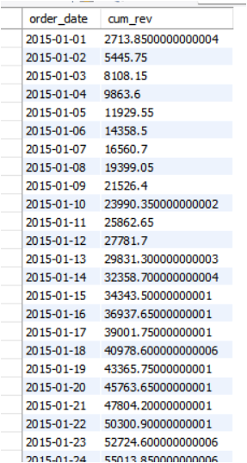
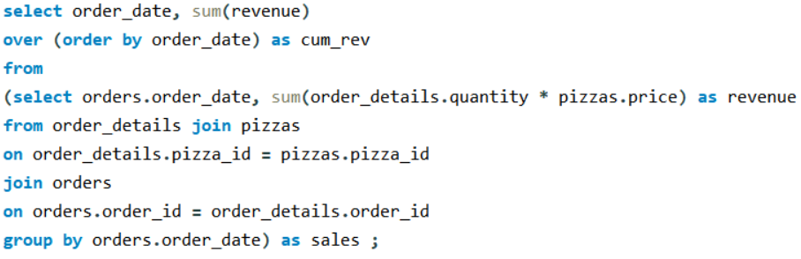
ANALYZE THE CUMULATIVE REVENUE GENERATED OVER TIME.
< BACK
NEXT >

Slide 16
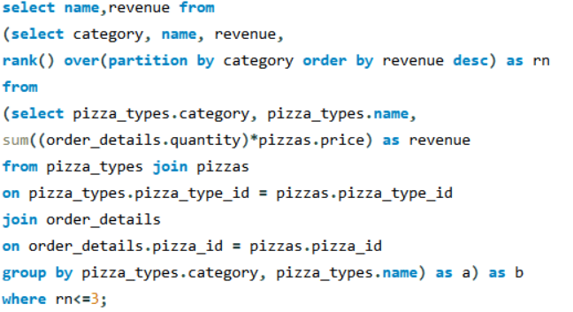
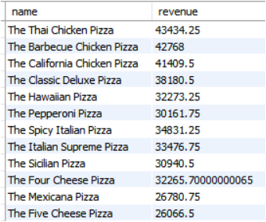
DETERMINE THE TOP 3 MOST ORDERED PIZZA TYPES BASED ON REVENUE FOR EACH PIZZA CATEGORY.
< BACK
NEXT >

Slide 17

CONCLUSION
Successfully analyzed pizza sales data using SQL queries.
Applied Joins, Aggregations, Date Functions, and Window Functions to extract deep insights.
Identified key performance metrics like:
Best-selling pizzas
Peak ordering hours
Top revenue-generating items
Category-wise and time-based trends
Enabled data-driven decision-making for menu optimization, pricing strategy, and inventory management.
Helped uncover valuable customer behavior patterns and operational opportunities.
< BACK
NEXT >

Slide 18
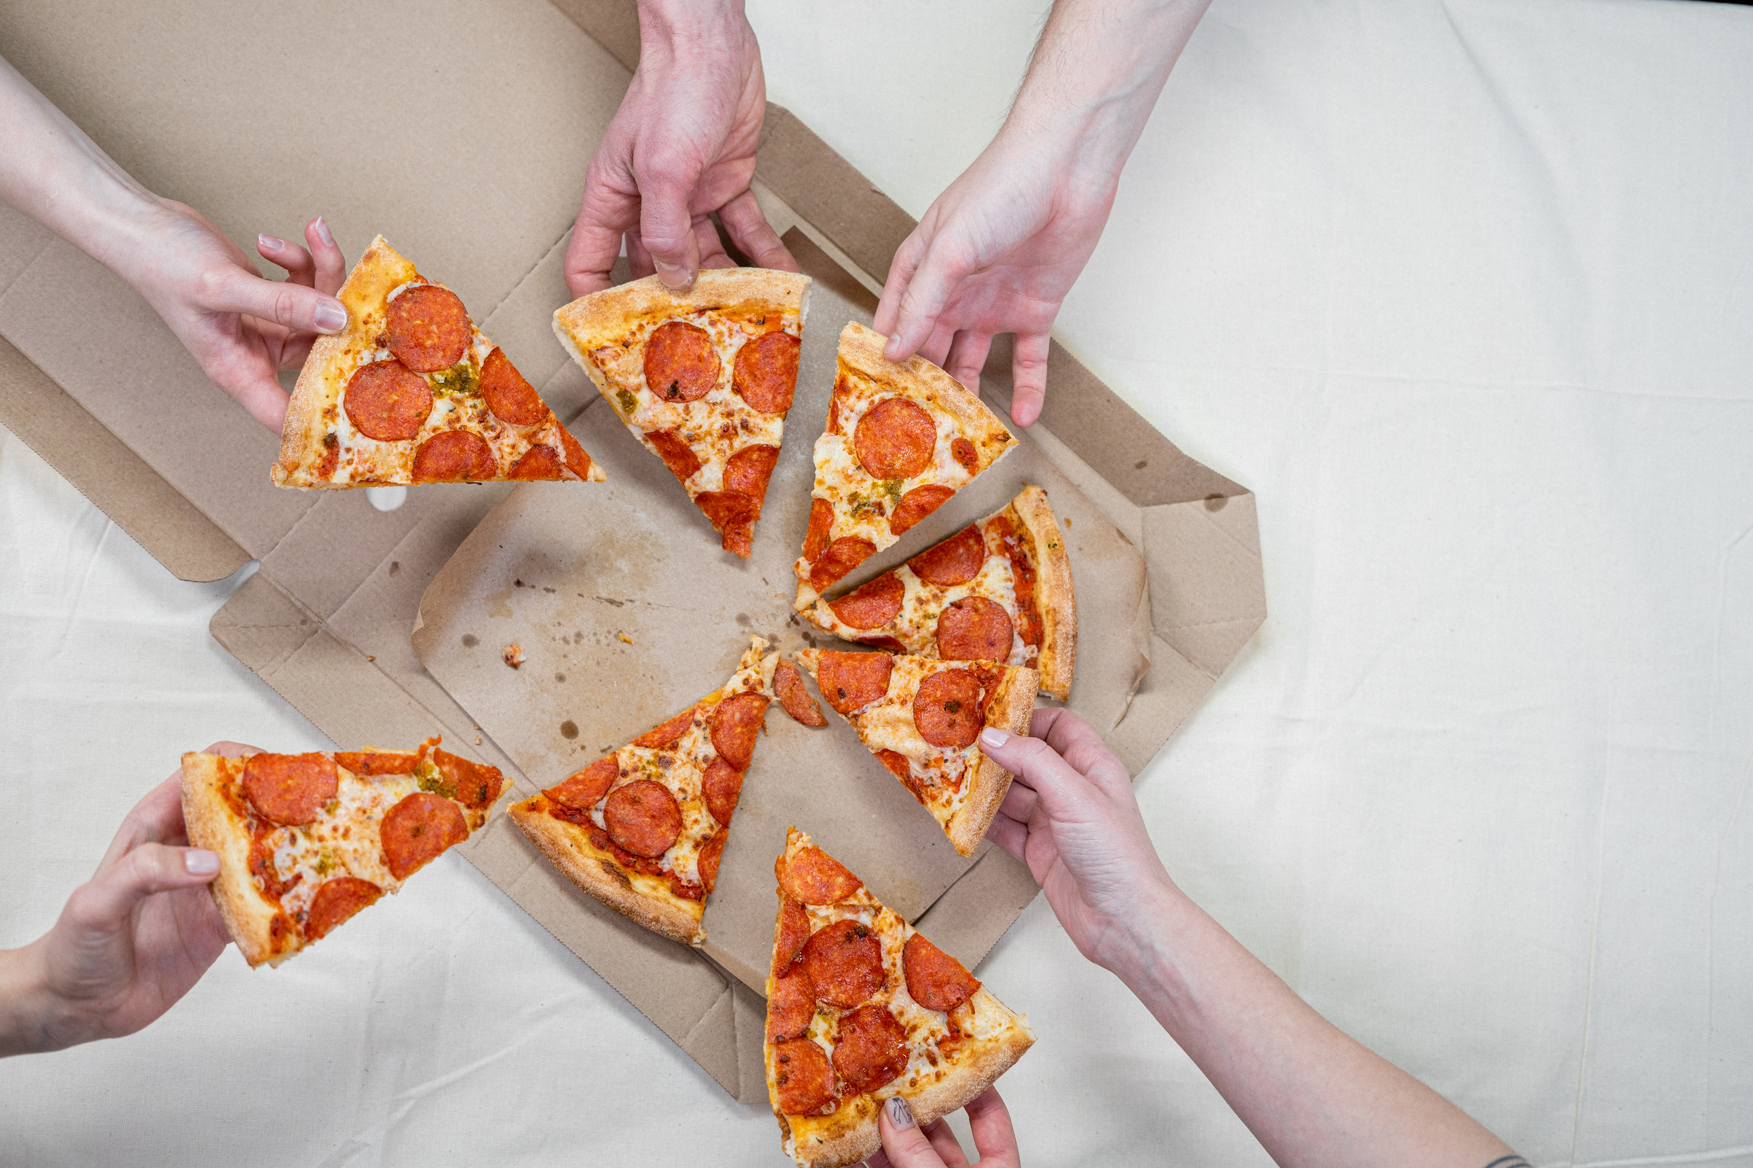

THANK YOU!
www.linkedin.com/in/riya-d-06897a289/
github.com/riyaditi
< BACK

